Slide 1






Location, location, location Border effects in interference limited ad hoc networks
Orestis Georgiou
Shanshan Wang, Mohammud Z. Bocus
Carl P. Dettmann
Justin P. Coon
MoN14
21 September 2015
CNET-ICT-318177

Slide 2


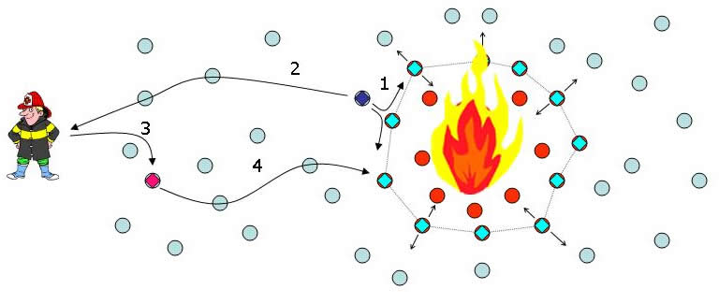
Motivation
IoT and WSNs
Temperature, pressure, humidity, etc.
Smart cities, smart buildings
e-Health
Co-channel Interference
Packet losses
Retransmissions
Delays
Energy waste
Overheads

Slide 3
Motivation for Theoretical approach
SINR model to design efficient MAC
Statistical framework
Network performance: Local / Global observables
Randomness (is good):
Multipath (fast fading)
Shadowing (slow fading)
Number and Location of wireless devices
Ad hoc, mesh net, mobile, physical constraints and costs
Power control
Cooperation or signalling overheads
MAC
ALOHA / CSMA
(Poisson) Point Process (with no carrier sensing)
“Poissonian Network” a theoretical abstraction (a playground)

Slide 4
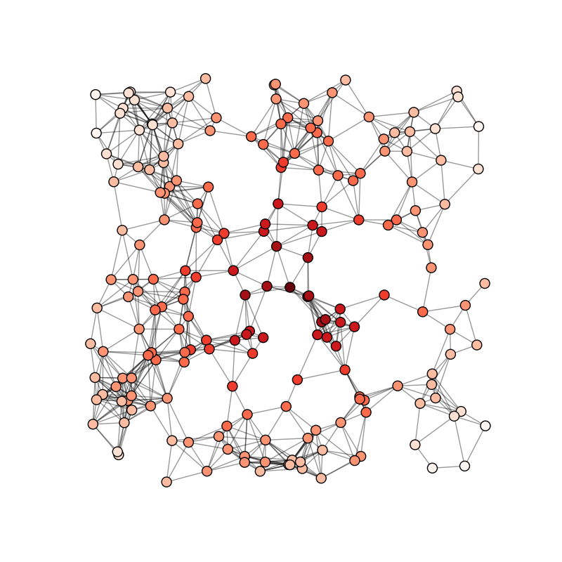
Motivation & Contributions
Topological inequalities in the network
Channel access unfairness in 802.11 where nodes at the border are typically favoured
Different locations of a receiver
The desired transmitter is at a constant distance from the receiver
Concurrent transmitters are uniformly distributed

Slide 5
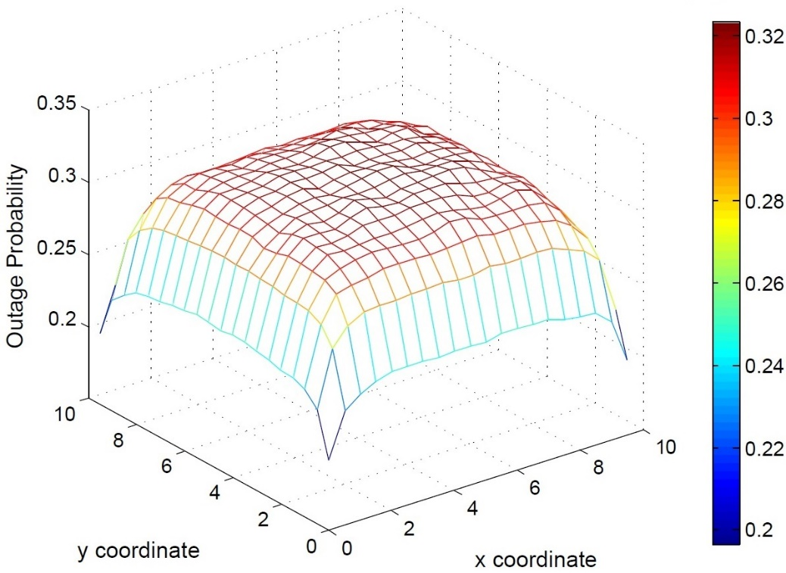
Motivation & Contributions
Topological inequalities in the network
Channel access unfairness in 802.11 where nodes at the border are typically favoured
Different locations of a receiver
The desired transmitter is at a constant distance from the receiver
Concurrent transmitters are uniformly distributed

Slide 6
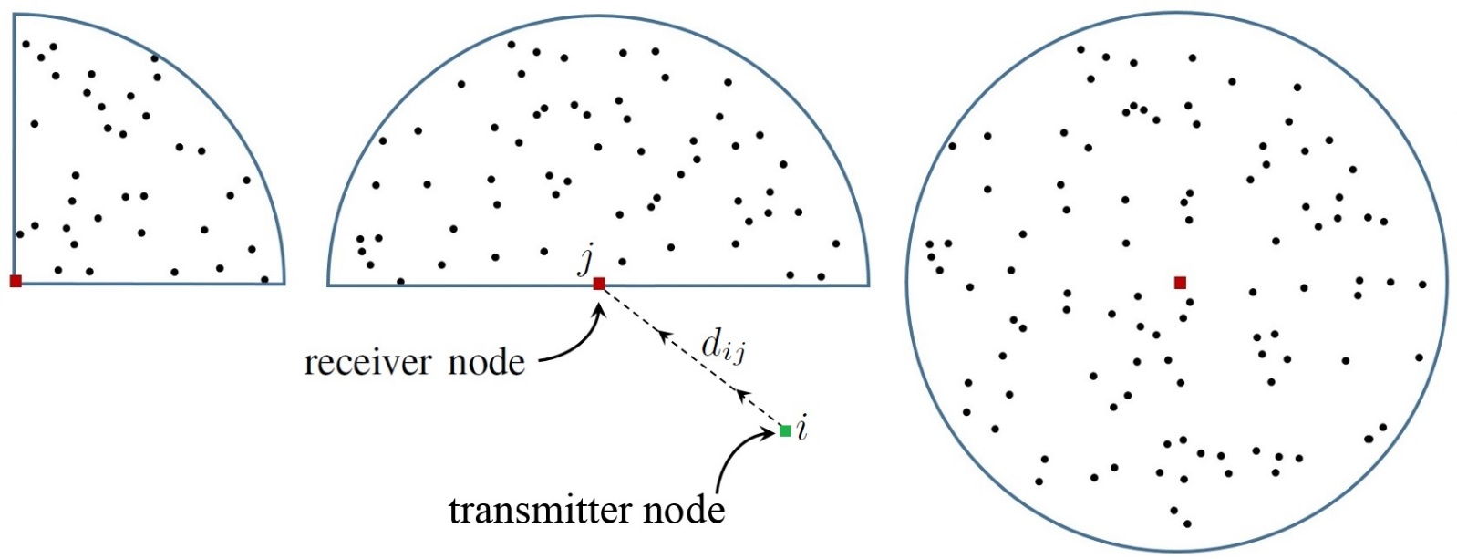
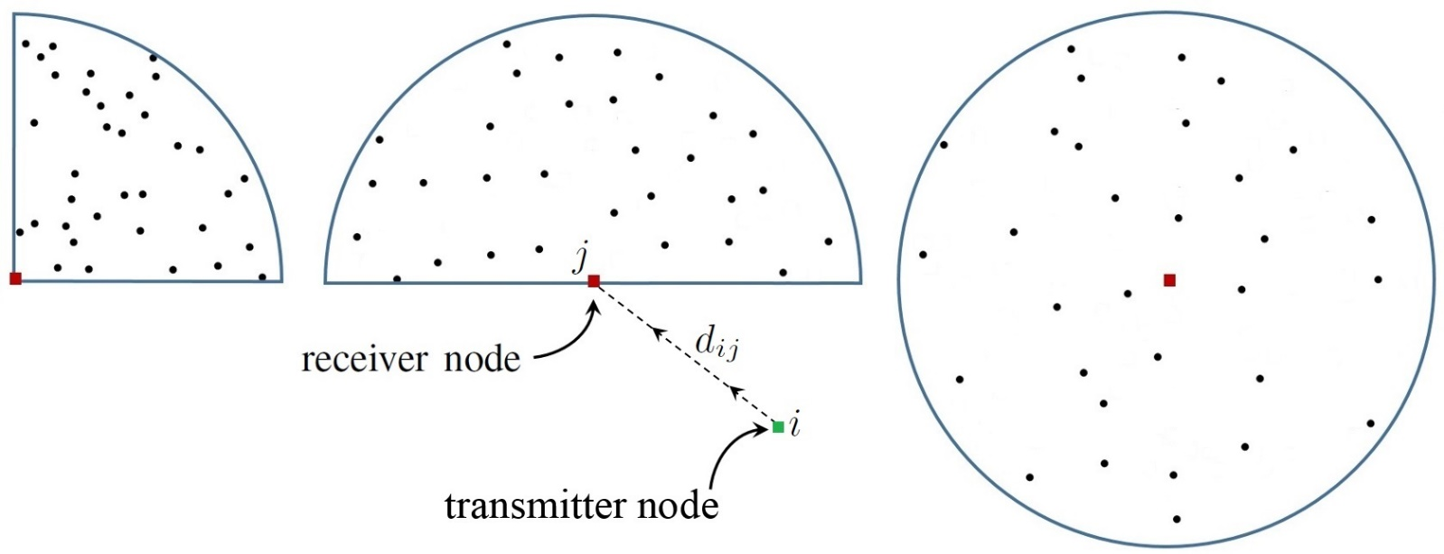
Motivation & Contributions
Interference experienced by a receiver is strongly dependent on its location within a finite network.
The location of the receiver is of equal importance as the total number of concurrent transmitting devices.
Contributions
Closed form expressions for:
Outage probability
Achievable ergodic rate
Spatial density of successful transmissions
1/2
1/2
1/4
1/4
1
1
Location, location, location: Border effects in interference limited ad hoc networks, OG et. al. WiOpt'15 (2015).

Slide 7
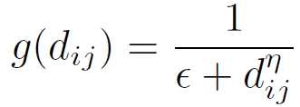
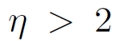
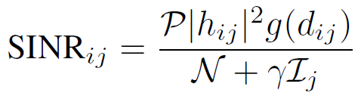
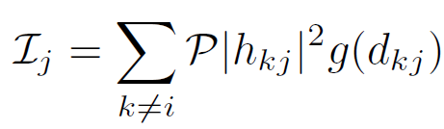
Model definitions
PPP (no carrier sensing)
Path loss function
Rayleigh fading
SINR at receiver
Path loss attenuation function
Path loss exponent
Channel gain
Interference factor

Slide 8
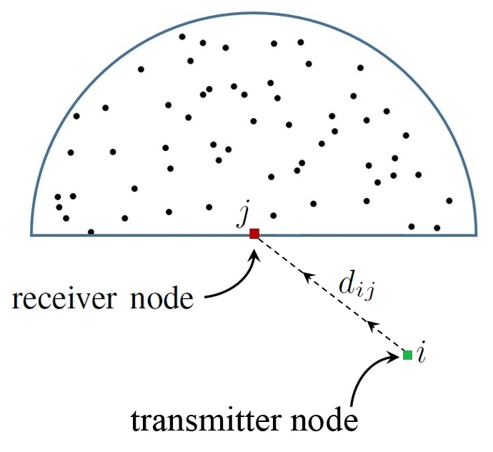
Model definitions
PPP (no carrier sensing)
Path loss function
Rayleigh fading
SINR at receiver

Slide 9
Coverage - standard approach
Connection probability
Connection probability
conditioned on the
received interference at j
Laplace transform of the r.v.
Ij evaluated at s
conditioned on the
locations of nodes ti and rj
J. G. Andrews et al, “A tractable approach to coverage and rate in cellular networks,” 2011

Slide 10
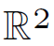
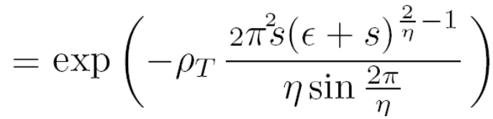
Coverage - infinite Nets
The probability generating function for a general inhomogeneous PPP
Requires that
Olbers’ dark night sky paradox (1823)

Slide 11

Coverage - infinite Nets
Why is the night sky dark?
Why is the night sky dark?
Kepler 1610
Kepler 1610

Slide 12
Coverage - from infinite to finite Nets
The probability generating function for a general inhomogeneous PPP

Slide 13
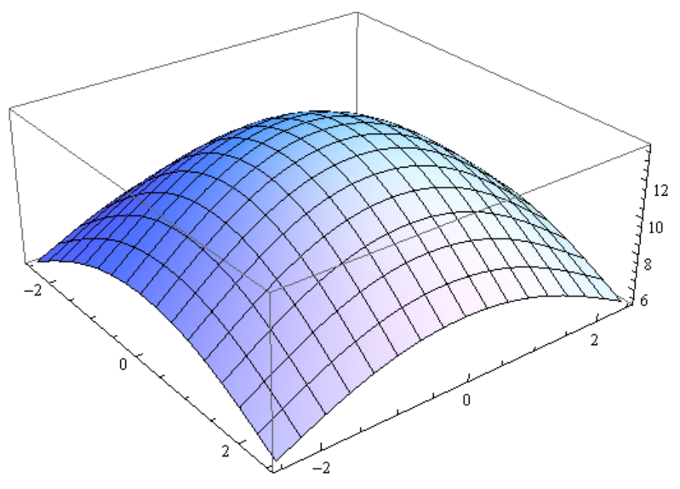
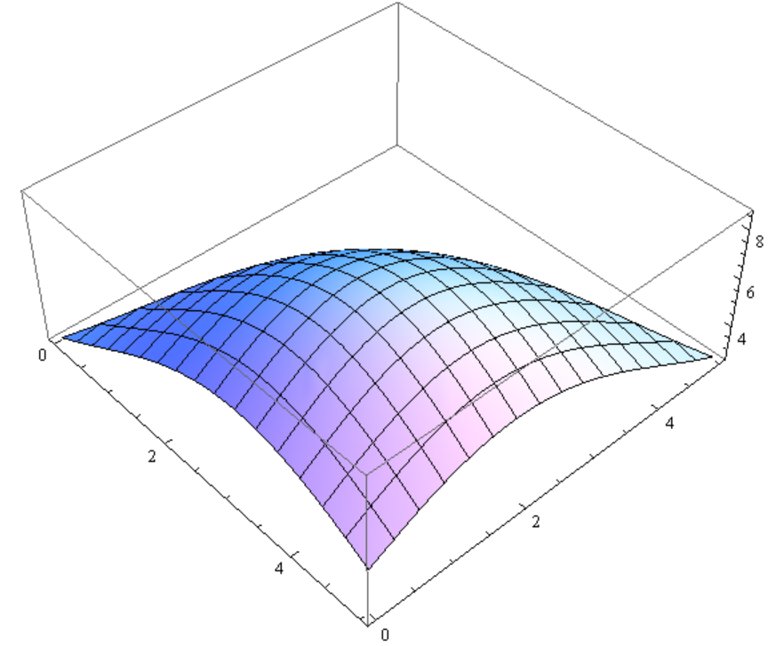
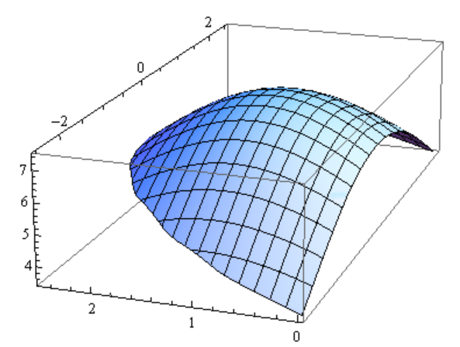
Coverage - from infinite to finite Nets
Topological inequalities in the network
Channel access unfairness in 802.11 and 802.15.4 where nodes at the border are typically favoured.
Routing, MAC, retransmission schemes can be smarter i.e. location and interference aware

Slide 14
Coverage - from infinite to finite Nets
Location, location, location: Border effects in interference limited ad hoc networks, OG et. al. WiOpt'15 (2015).

Slide 15
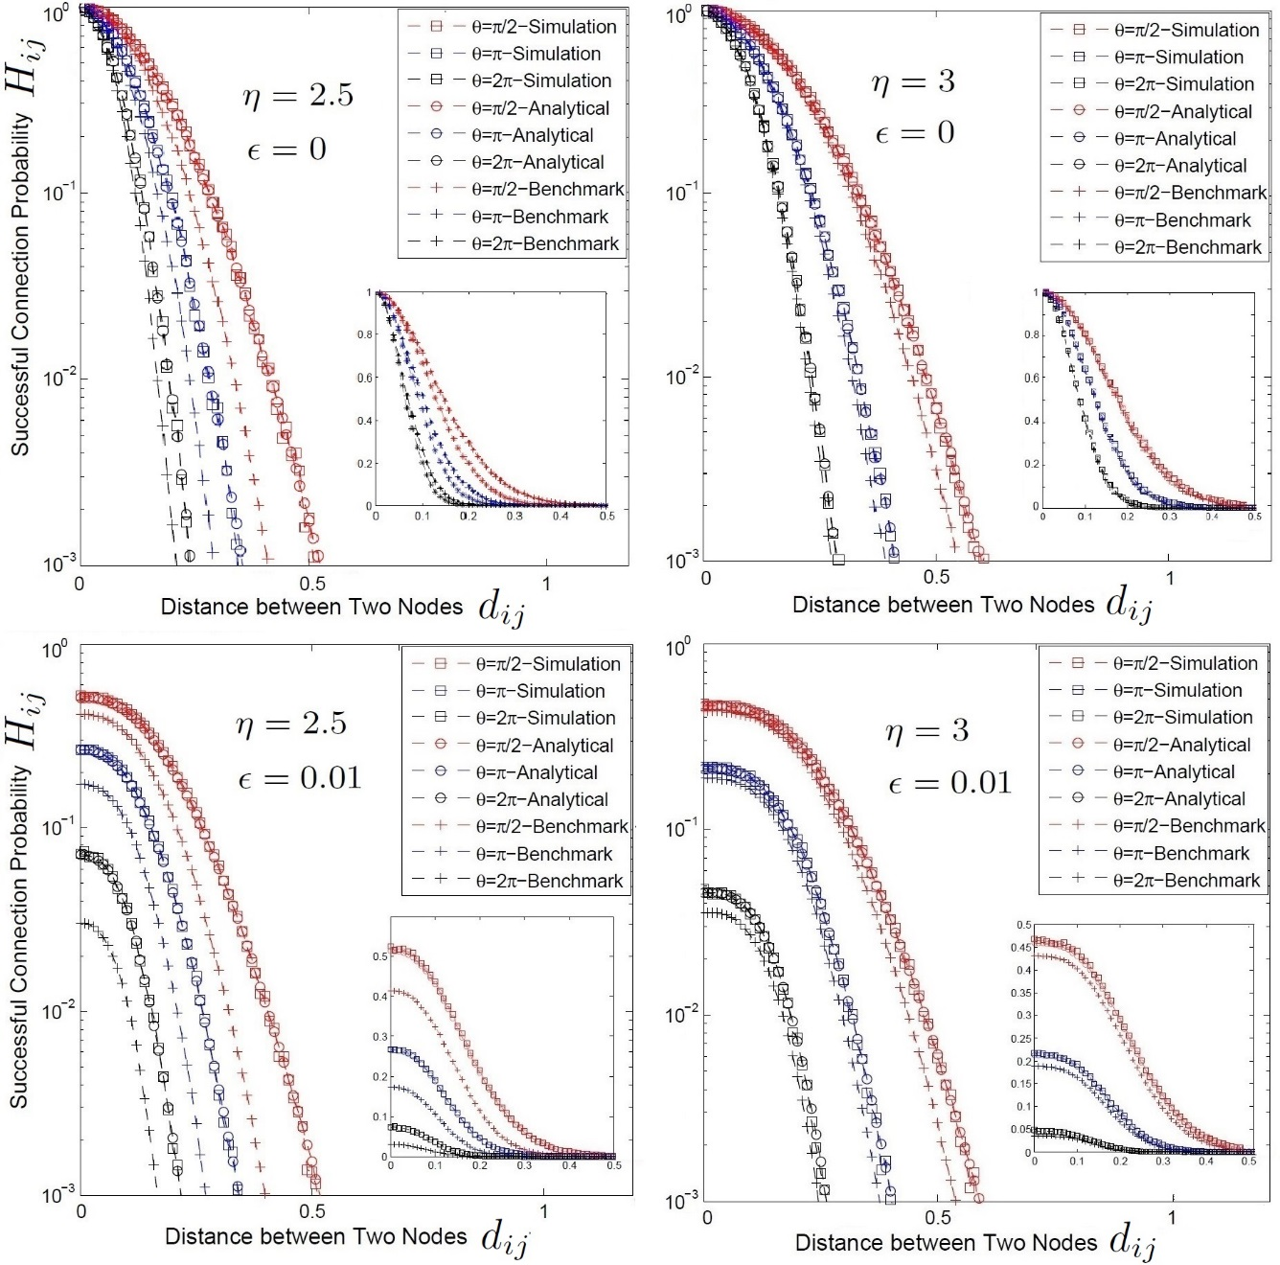
Coverage - from infinite to finite Nets
Location, location, location: Border effects in interference limited ad hoc networks, OG et. al. WiOpt'15 (2015).

Slide 16
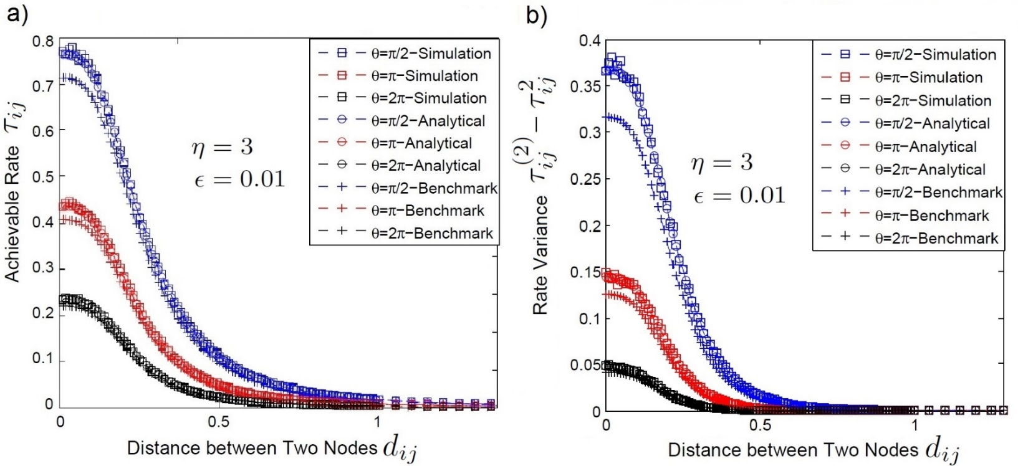
Capacity - from infinite to finite Nets
Location, location, location: Border effects in interference limited ad hoc networks, OG et. al. WiOpt'15 (2015).

Slide 17
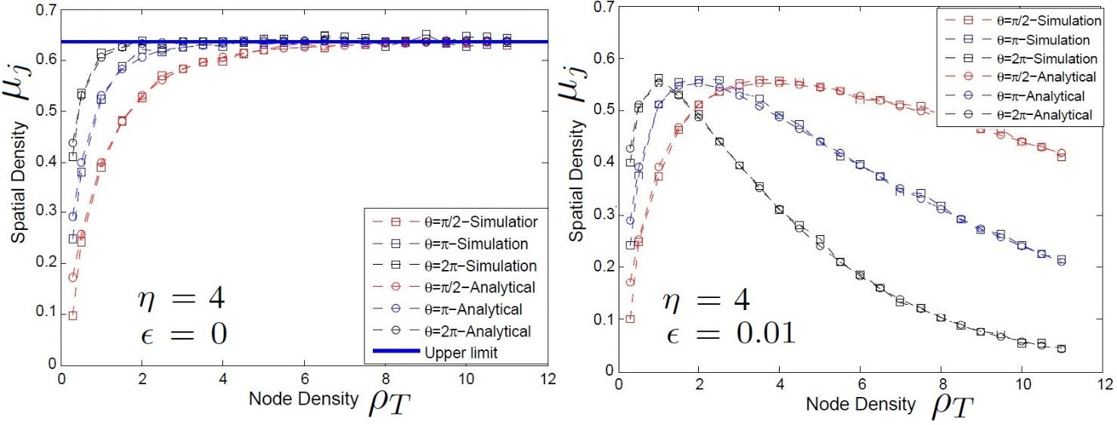
Spatial density of successful transmissions
How many signals can the receiver rj decode successfully?

Slide 18
Discussion and Summary
The location of the receiver is equally important to the total number of concurrent interfering transmissions
Location, location, location
Routing, MAC, retransmission schemes can be smarter
i.e. location and interference aware.
Location, location, location: Border effects in interference limited ad hoc networks, OG et. al. WiOpt'15 (2015).

Slide 19
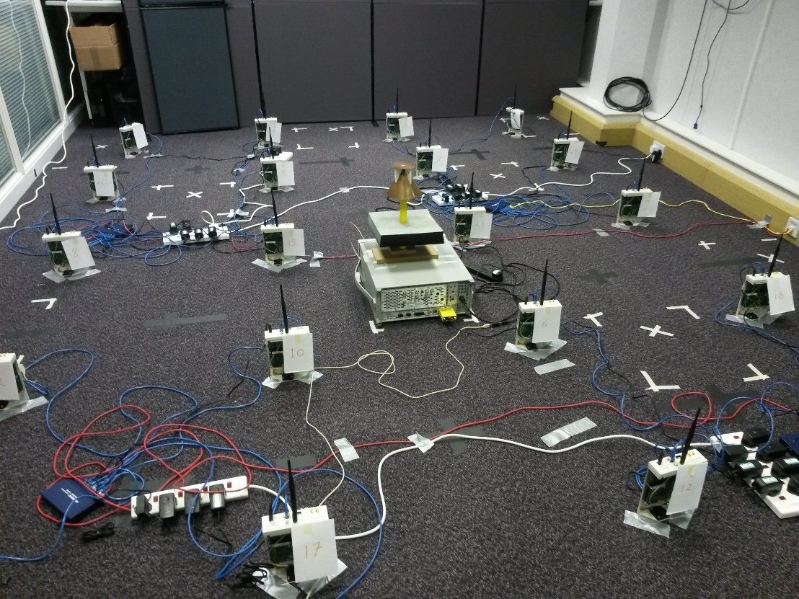
Motivation & Contributions
Topological inequalities in the network
Channel access unfairness in 802.11 where nodes at the border are typically favoured
Thank you for your attention!

Slide 20



